Slide 1
Save $$ Testing Code the Playback-Based Way
William Clements
Autodesk

Slide 2
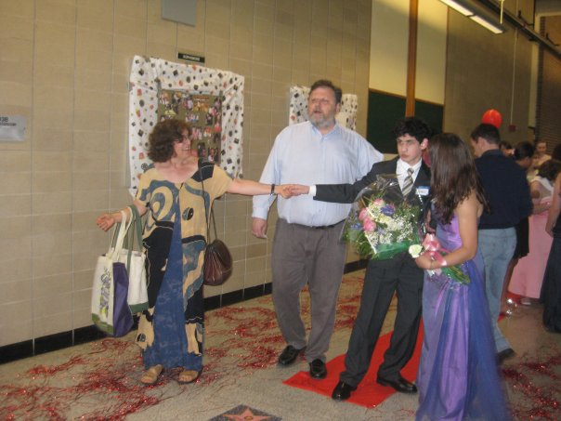
About Me
Codeslinger
About Autodesk
Make Anything!

Slide 3
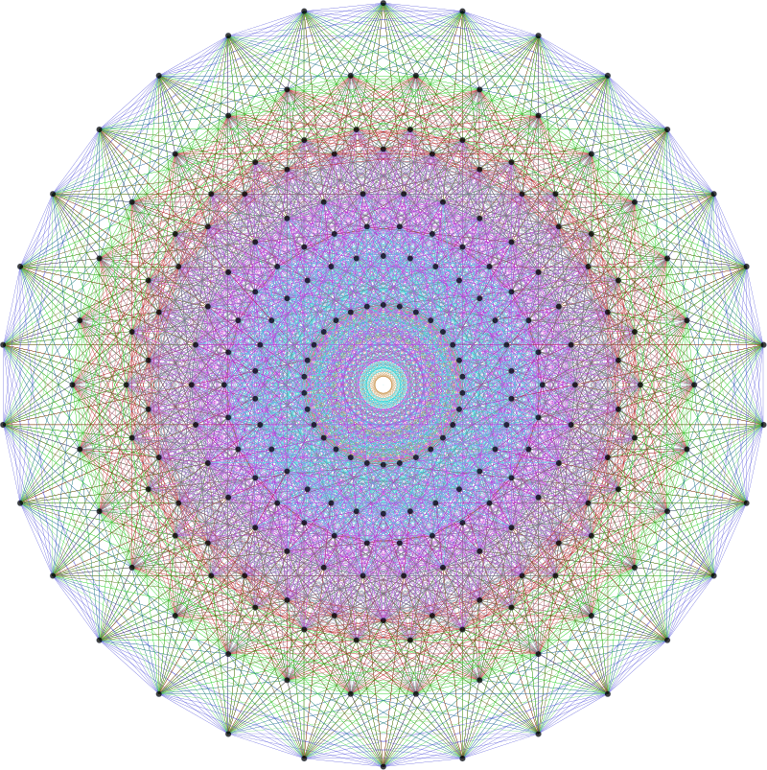
Purpose – champion Playback Based Testing (PBT) for C++ libraries
Outline:
1. Library Scaling Dilemma
2. Anatomy of Playback Based Testing
3. PBT never works? Revit Journaling story
4. A tour of CppPlayer – reference implementation

Slide 4
Coming slides - a playful look at Value Proposition.
Keep in mind:
Library (integration) quality as an issue is shared between library & client
PBT is a shared solution
Evaluate PBT’s Return On Investment (ROI)
Do It Yourself

Slide 5

Your library is inadequately tested! …
… you cannot run ALL of your clients' software for regressions

Slide 6
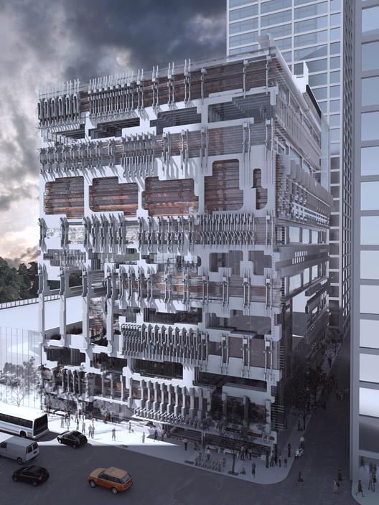

Your library is scaling up and collecting satisfied clients
You release new versions, happy clients accept them

Slide 7

Your great enhancements snag some (newer) clients

Slide 8

… can regress quality for older clients

Slide 9

Dilemma or Quandary?
How can we qualify our library against so many different clients’ needs?
I.E., how can we test the integration of the library with each client library or application?

Slide 10
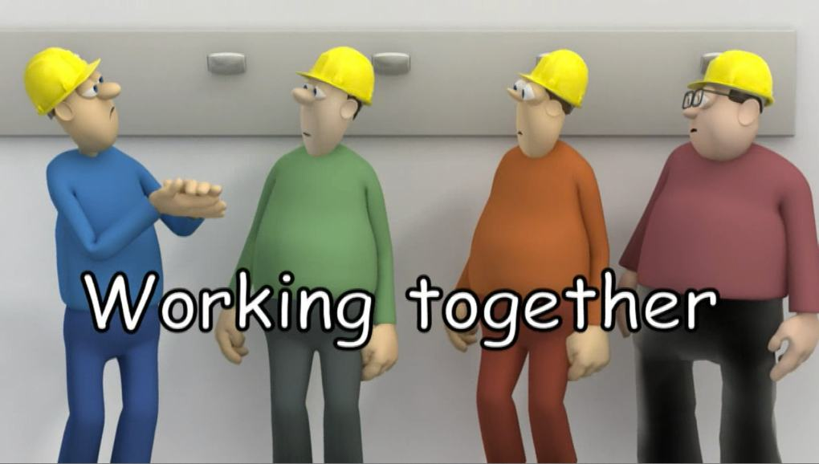
You need more data from clients to solve this problem.
Work together to capture an exact recording of live sessions.

Slide 11

PBT Anatomy
Capture all data entering library
in form of
API names + argument values

Slide 12
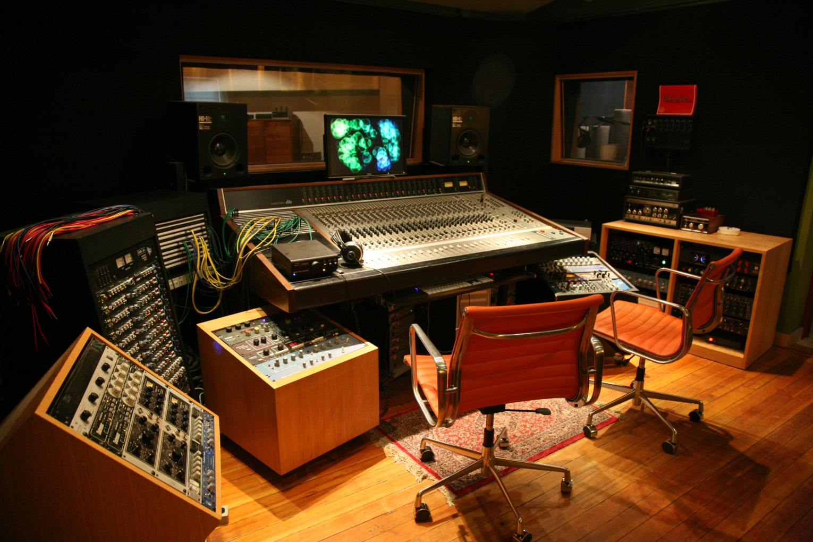
PBT Anatomy
“Recordings” played back in absence of client code
expose Regressions!

Slide 13
PBT Anatomy
“Recordings” played back in absence of client code
expose Regressions!

Slide 14
PBT Anatomy
“Recordings” played back in absence of client code
expose Regressions! Breaking changes

Slide 15
Client or application code
Client or application code
Refactor
API + Business Logic
API + Instrumentation + Business Object Wrappers
Business Logic

Slide 16
Client or application code
JSON files
Capture
Thin Test runner
API + Instrumentation + Business Object Wrappers
API + Instrumentation + Business Object Wrappers
Playback
Business Logic
Business Logic

Slide 17
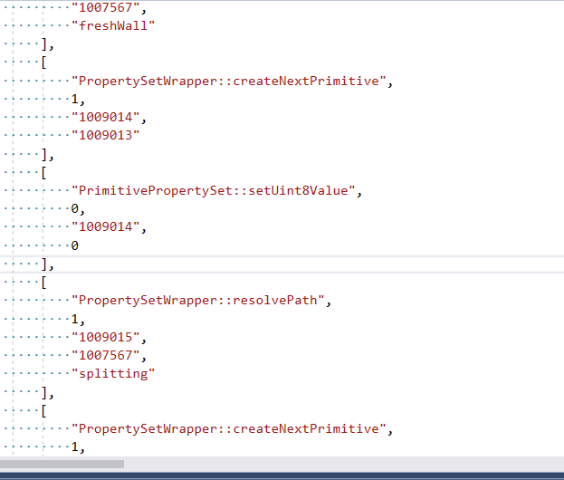
Next let’s look at a previously captured artifact in JSON format…see the calls?
JSON is well-structured for transformational edits…. to accommodate programming interface changes

Slide 18
Engineering Tips
Clean Lab approach – e.g. initial state of files referenced by the playback artifact
No secret back-door calls
Endure “taxes” – unpleasant tasks and costs
Raise exception when something goes “out of sequence”
Referenced object missing
Function return mismatch
Etc.

Slide 19

Similar methodology used for testing commercially successful Autodesk Revit product for over 15 years.
Autodesk Revit team runs 19,000 recorded tests almost once a day.

Slide 20
Case: Revit HFDM integration
Team immersed in Revit PBT culture
Facing flaky integration with HFDM (cloud storage framework)
Already having wrapper objects covering most HFDM calls.
Started Cpp Call Player tool (at CppCon 2017)
It worked
Isolated performance problem and other benefits
Distilled core of tool into “CppPlayer”

Slide 21
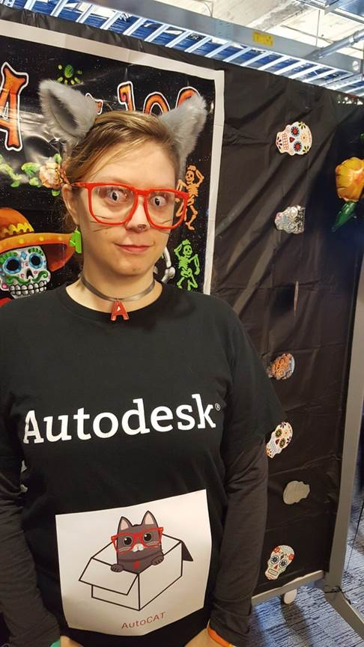
https://github.com/WilliamClements/CppPlayer
Get into it!
Adapt it!
Contribute to it!

Slide 22
CppPlayer supports both recording and playback
1200 Lines of code
Headers Only
Open Source (Apache 2.0)
Adoption strategy in the ReadMe markdown

Slide 23
CppPlayer
Header-only library - API adapter for Playback-Based Testing
Steps to integrate CppPlayer:
Derive your operational base class from IOperational.
Insert following static method into that base class declaration.
static inline CallMap& libraryCallMap() { static CallMap yourCallmap; return yourCallmap; }
To wrap each of your business objects, derive a class from your operational base class.
Derive your main business object from IMain.
Instrument your business object wrappers.
The framework requires that wrapper objects instantiate using std::shared_ptr
Instrumentation:
From each instrumented API, invoke recordFunction at the end.
(Or recordMethod if function returns void).
Declare and implement a playback method.

Slide 24
CppPlayer is a reference implementation
This type of tool is much more “grow your own” than it is “off the shelf”!

Slide 25
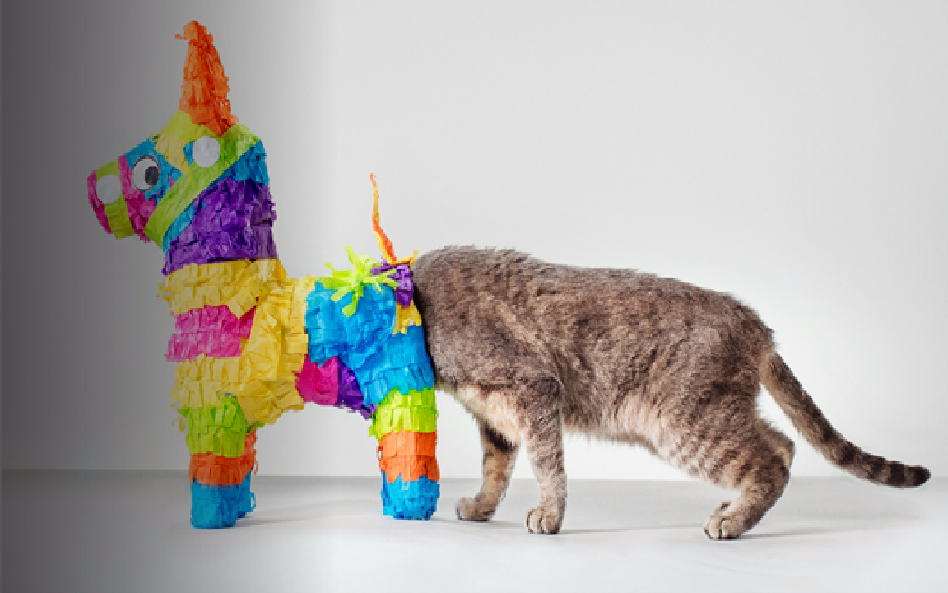
Curious to see what’s inside?

Slide 26
Call Stream = sequence of captured C++ calls symmetrically deployed in Recording and Playback
As calls pass through the stream, the Recorder (or Player)
Serializes/Deserializes call arguments
Unswizzles/Swizzles pointers (objects)
Lossless type conversion

Slide 27
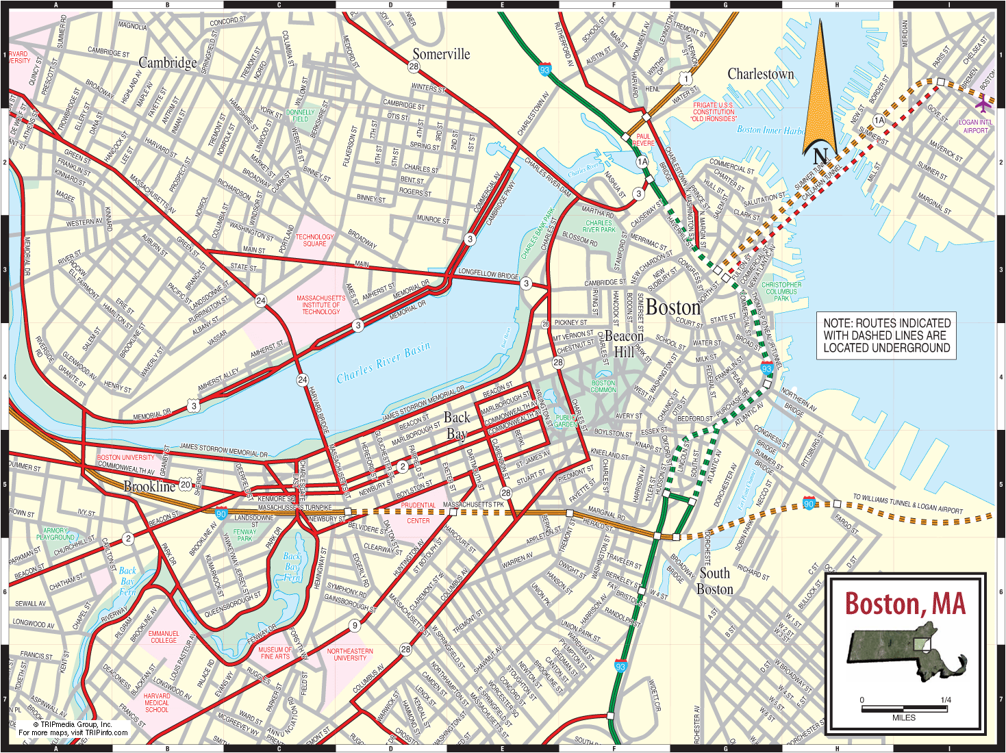
Call Map = string -> “call object”
Static initialized
One per instrumented lib
Type-erased functors outside
Type-full lambdas inside
PropertySetWrapper::resolvePath
WorkspaceWrapper::commit

Slide 28
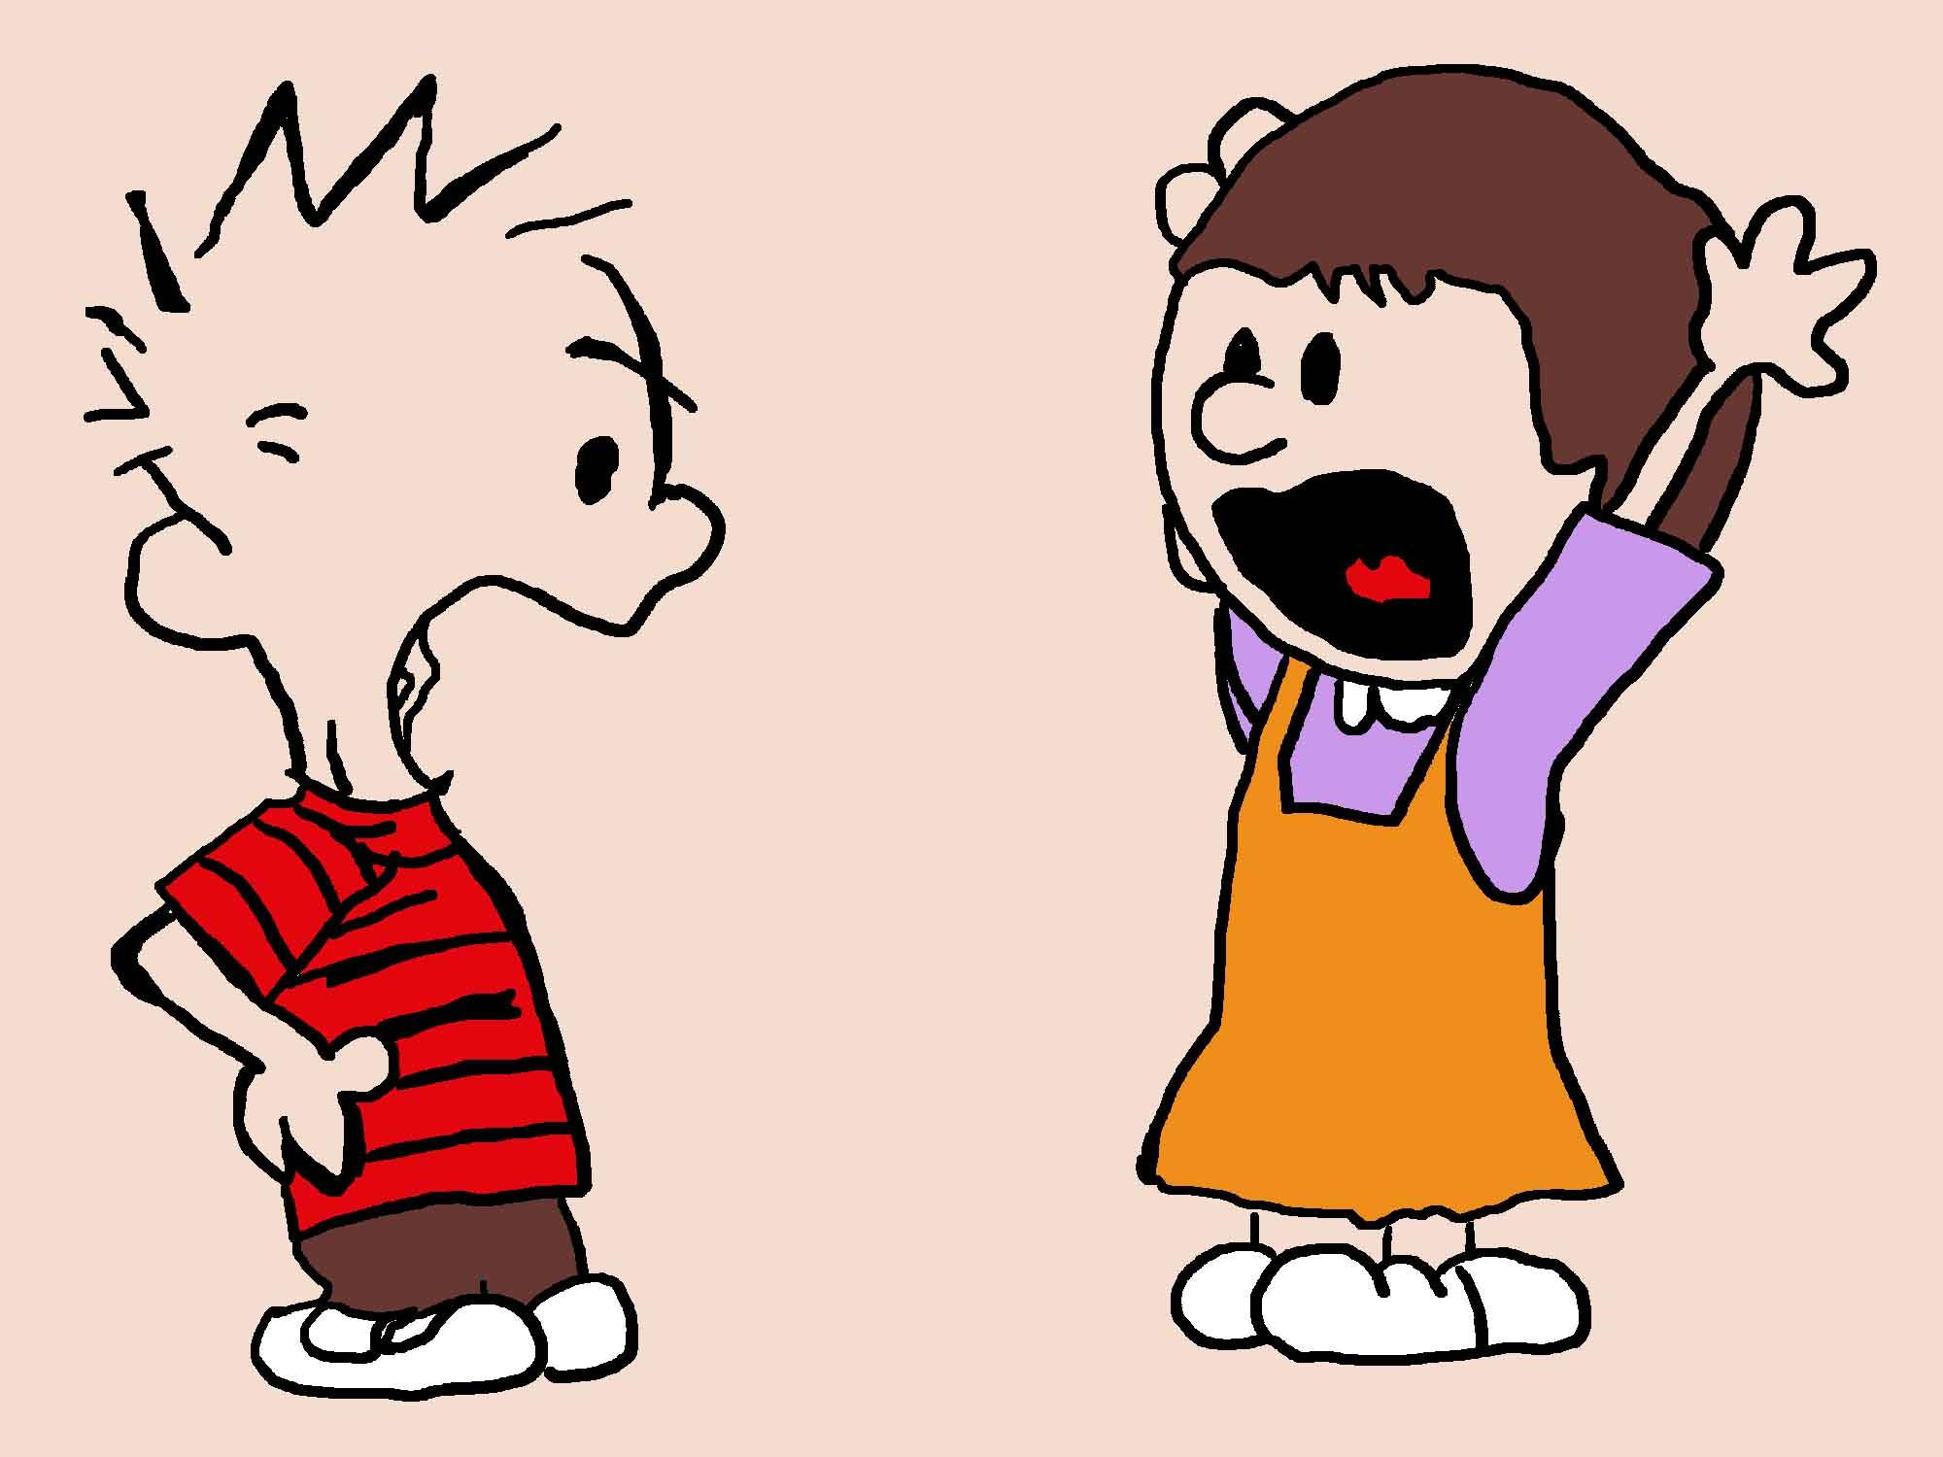
Arguments
For a given Call…
ArgsWriter pushes each
ArgsReader pops

Slide 29
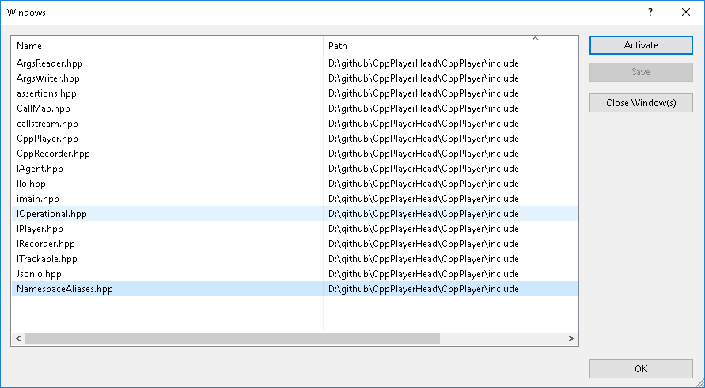

Slide 30
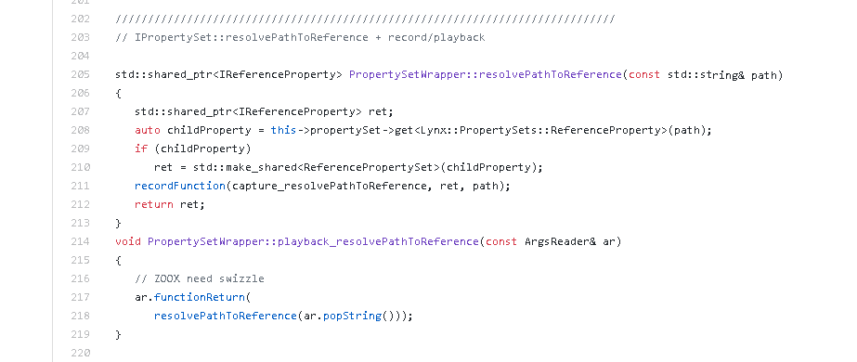

Slide 31
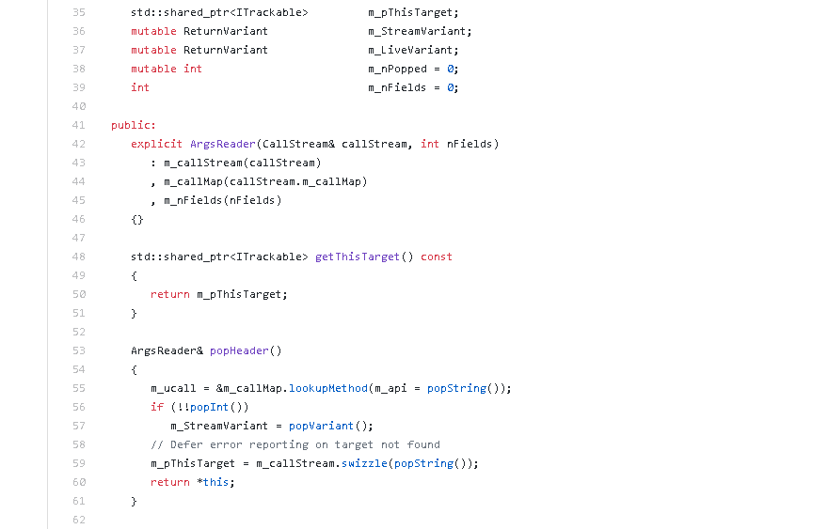

Slide 32
CppPlayer
https://github.com/WilliamClements/CppPlayer
integration testing paradigm
William Clements
Autodesk

